Slide 1
Enterprise Programmering 1 Lesson 09: Selenium and JaCoCo
Dr. Andrea Arcuri

Slide 2
About these slides
These slides are just high level overviews of the topics covered in class
The details are directly in the code comments on the Git repository

Slide 3
Software Testing

Slide 4




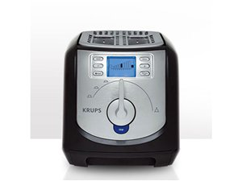







Software is everywhere!!! (not just enterprise systems…)

Slide 5
Are software applications doing what are they supposed to do?

Slide 6


Ariane 5 – ESA
On June 4, 1996, the flight of the Ariane 5 launcher ended in a failure.
$500 millions in cost
Software bug

Slide 7

Fatal Therac-25 Radiation
1986, Texas, person died

Slide 8

Power Shutdown in 2003
Nearly 50 million people affected in Canada/US

Slide 9

2010, Toyota, bug in braking system, recalled 436,000 vehicles…

Slide 10
Knight Capital Group 2012
$460 millions lost in 45 minutes of trading due to bug

Slide 11
And I could go on the whole day…
As of 2013, estimated that software testing costing $312 billions worldwide
In 2016, 548 recorded and documented software failures impacted 4.4 billion people and $1.1 trillion in assets worldwide

Slide 12
Why??? A common problem… no tests!

Slide 13
Software Testing
Software has bugs, ie implementation mistakes
All developers write bugs, not just students, even senior developers
eg, in the writing of the code of this course there were (and might still be) several bugs, which you can check by looking at the commit logs in the Git history
Testing helps you to find bugs before it is delivered to customers
However, testing does NOT guarantee the absence of bugs…

Slide 14

Manual Testing
Start the application you are developing
Use it, and manually check if it is working correctly
eg, should not crash and should get expected behavior
Try to follow common usage scenarios for the application
Also try uncommon scenarios, to check if still working correctly
Software Tester: an employee whose work is to test the application before each new release/feature

Slide 15
Problems of Manual Testing
Many people finds it boring…
It is not systematic: a manual procedure can miss/forget to test important scenarios and edge cases
It is expensive: software testers still need a salary to feed their families…
Every time there is a code change, new bugs might be introduced, and previous testing is invalidated
ie, have to do it again, and again, and again, and …
Still, you need to have a manual testing phase (eg before a major release to customers), but you also need something more besides manual testing

Slide 16
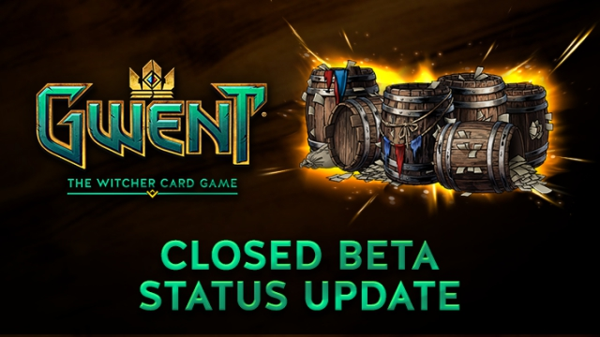

Beta Testing
A type of manual testing you might be familiar with, especially in regards to video-games
Release the software in a “beta” state to a group of potential users, which will test it for free!
Very common in online games, especially to test large loads on servers before a main release

Slide 17
Testing Depends on Context
If there is a bug in a video-game, players will just have a to wait for a patch…
although if too many bugs at launch, it will hurt sales…
If there is a bug in an enterprise system dealing with critical assets (e.g., a bank), you might be screwed…

Slide 18
Automated Testing
Write code that can automatically run tests against an application, or parts of it (e.g., single functions or classes)
Benefits:
you can test single parts of the application
can re-execute all tests every time there is a code change to see if these new changes break current functionalities

Slide 19
Kinds of Testing
Unit Testing
test units (functions/classes) in isolation
Integration Testing
scenarios in which different components are involved
System Testing
test the whole application, going through the same interfaces (e.g., a GUI) that a user would use to interact with it
But there are many others
User Testing, Security Testing, Performance Testing, Robustness Testing, etc.

Slide 20
Running Tests in Java
The main framework is JUnit
others are like for example TestNG and Spock
Not just for unit testing, but any kind of testing
eg, the Arquilliain and Spring service tests can be considered as integration tests

Slide 21
Maven and Tests
Maven can run tests as part of the build
It makes distinctions between unit and integration tests
But these are JUST names, and NOT necessarily related to the concepts of unit and integration testing
ie, could run unit tests in Maven like they were integration ones
unit: run by Surefire plugin, name pattern “*Test.java”, executed BEFORE the “mvn package” phase (jar/war file not built yet)
integration: run by Failsafe plugin, name pattern “*IT.java”, executed AFTER “mvn package” (so can use the built JAR/WAR file)

Slide 22
When to use “*IT.java”
If your tests need to use the generated JAR/WAR file
eg, you want to start the actual built application
If your tests are long to execute (e.g., system tests), and you do not want to run them each time you just need to do a “mvn package”
eg, you just want to quickly build the application for some manual testing, although you still want to run the quick unit tests, just in case…

Slide 23
Selenium

Slide 24
Selenium
Tool that enables you to interact and control a browser from code
Written in Java, but used as a tool in many different languages, eg C#/.Net
Main use: ability to write system tests for web applications, in which you first start the server, and then control the browser (eg click buttons) like it was a real user

Slide 25
Selenium Requirements
In Java, imported as a JAR library
Can be called directly from JUnit
MUST have a browser (e.g., Chrome) AND the Selenium drivers for such browser (which you need to install separately)
Note: can also use Docker to run an image with a browser and drivers already configured… but then it is more difficult to debug, as no simple direct access to the browser GUI running inside the Docker image
Note: can run same tests against different browsers

Slide 26
HTML Interactions
For Selenium to interact with the HTML components, it needs to locate them first
Easiest way is to add “id” attributes to the HTML tags we want to click on or type inputs in
At times though, we need more sophisticate queries
eg, check how many rows there are in a table, or how many tags have a specific attribute
Needed for validation: e.g., after you click a button, you want to check that indeed a new row was added on a displayed table

Slide 27
XPath
Query language on tags in HTML/XML documents
https://www.w3schools.com/xml/xpath_syntax.asp
A HTML/XML document can be represented as a tree, on which tags/nodes can be identified with a path
A path expression can match several tags/nodes
An alternative to XPath is “CSS Selectors”

Slide 28
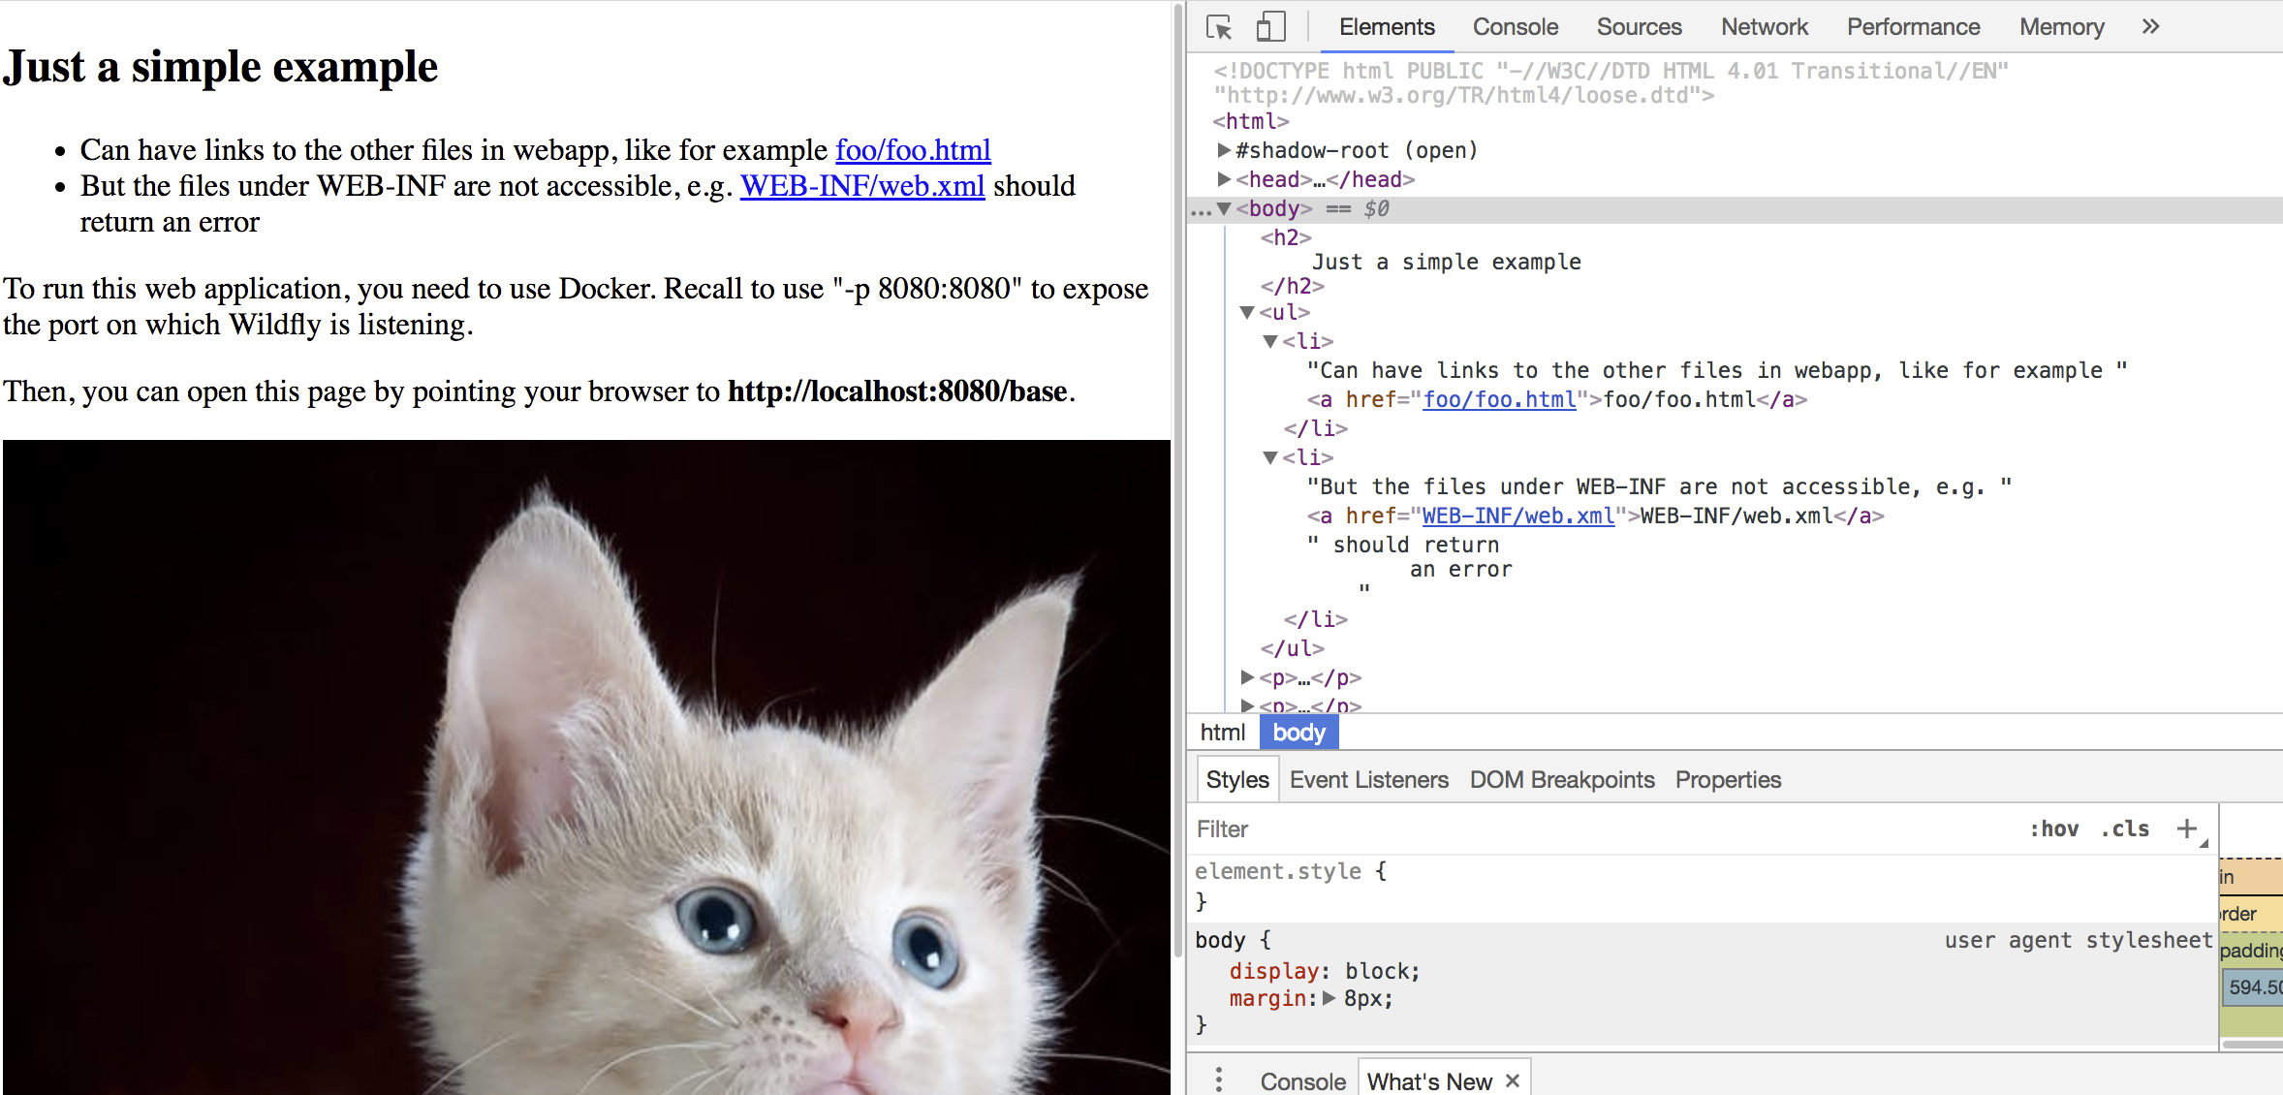
Recall first example of web page we had

Slide 29
<HTML>
<head>
<body>
<title>
<h2>
<ul>
<p>
<p>
<div>
<li>
<li>
<img>
<p>
<a>
<a>
<a>

Slide 30
XPath: Path Expressions
“nodename”: select all tags with given node name
“/”: select from root node
“//”: select anywhere inside current sub-tree
“.”: select current node
“..”: select parent of current node
“@”: select attribute
“*”: select all nodes
“@*”: select all attributes

Slide 31
XPath: //p
All tags <p>, wherever they are
<HTML>
<head>
<body>
<title>
<h2>
<ul>
<p>
<p>
<div>
<li>
<li>
<img>
<p>
<a>
<a>
<a>

Slide 32
XPath: //body//p
All tags <p> in the subtree of any
<body> tag, wherever this latter is
<HTML>
<head>
<body>
<title>
<h2>
<ul>
<p>
<p>
<div>
<li>
<li>
<img>
<p>
<a>
<a>
<a>

Slide 33
XPath: //body/p
All tags <p> directly under a
<body> tag, wherever this latter is
<HTML>
<head>
<body>
<title>
<h2>
<ul>
<p>
<p>
<div>
<li>
<li>
<img>
<p>
<a>
<a>
<a>

Slide 34
XPath: //div/p/a
All tags <a> directly under a <p>,
which itself is under a <div>
<HTML>
<head>
<body>
<title>
<h2>
<ul>
<p>
<p>
<div>
<li>
<li>
<img>
<p>
<a>
<a>
<a>

Slide 35
XPath: //p/..
All parent nodes of <p> tags
<HTML>
<head>
<body>
<title>
<h2>
<ul>
<p>
<p>
<div>
<li>
<li>
<img>
<p>
<a>
<a>
<a>

Slide 36
XPath: Predicates
Predicate inside “[]” to select a subset of all nodes matching the path
Can also be the index to specify one node among the list of the returned ones from the XPath
WARNING: it starts from 1, not 0…

Slide 37
XPath: //li[2]
From the list of all <li> from left to
right, return the second one
<HTML>
<head>
<body>
<title>
<h2>
<ul>
<p>
<p>
<div>
<li>
<li>
<img>
<p>
<a>
<a>
<a>

Slide 38
XPath: //li[2]/a
From the second in the list of all <li>
from left to right, return all the <a>
directly under it
<HTML>
<head>
<body>
<title>
<h2>
<ul>
<p>
<p>
<div>
<li>
<li>
<img>
<p>
<a>
<a>
<a>

Slide 39
XPath: //*[@href]
All nodes that have an attribute
called “href”
<HTML>
<head>
<body>
<title>
<h2>
<ul>
<p>
<p>
<div>
<li>
<li>
<img>
<p>
<a>
<a>
<a>

Slide 40
XPath: //*[string-length(text()) > 60]
All nodes that have a text content of
at least 60 characters
<HTML>
<head>
<body>
<title>
<h2>
<ul>
<p>
<p>
<div>
<li>
<li>
<img>
<p>
<a>
<a>
<a>

Slide 41
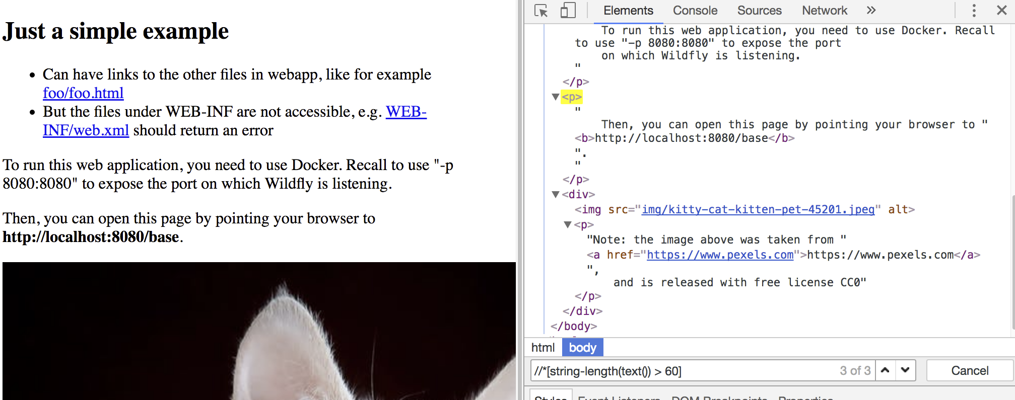
The “Search” in Chrome Developer Tools can use XPath
Good to check validity of queries before running your Selenium tests

Slide 42
Maintenance
In the Selenium tests you need to use XPath to locate HTML elements, eg to click buttons
XPaths can be arbitrarily complex
You might need to traverse the same page in many different Selenium tests
eg, use Sign Up page to first create a user
The HTML in a page can change, and you do not want to have to update the XPath in every single Selenium test using such page

Slide 43
Page Object (PO)
A PO is a Java class used in testing to encapsulate all the actions you can do on a web page
You will have a PO for each web page
A PO can have methods like “clickLoginButton()”
the details of actually interacting with the DOM will be inside such PO method
Selenium tests should not access the HTML/DOM directly, but rather just use the POs
If a method in a PO represents a page transition (eg, clicking on a link), then such method should return the PO of the new page
If the HTML of page change, you need to ONLY update its PO, and not the hundreds of Selenium tests using it…
It also makes the Selenium tests much easier to understand

Slide 44
Unit or System Tests???

Slide 45
Which tests to write?
Should you just write unit tests?
Or should you just write Selenium tests?
A mix of both?
Which tests are more useful?
Which ones should you prioritize?
When to decide that you have enough unit tests and should add more Selenium ones?

Slide 46
Issues with Unit Testing (UT)
A lot of code can be trivial (eg getters and setters). UT for them would be a waste of time
When a class has complex dependencies to other classes (eg, inputs in constructors, like 5 other class instances), writing UT might be cumbersome
To test your whole system at UT level, you might need thousands and thousands of tests… as each one may test very little

Slide 47
Issues With System Testing (ST)
Usually much slower than UT
eg, start a browser, then start a server, click buttons on browser that send HTTP commands to the server, etc…
If a ST fails, much more difficult to find out why, as much more code is executed

Slide 48
So, UT or ST???
Write UT for classes/functions YOU think are complex
unit tests are easier to debug
Make sure to have ST for all the main functionalities of your system
make sure main functionalities are working, and those will cover a lot of the basic code
When a ST fails due to bug, to help debugging start writing UT and integration tests for related classes (if they have bugs, maybe they were not as easy as you thought…)

Slide 49
Testing as an Art
Unfortunately, testing is more like art than science
Usually just rules of thumbs, based on anecdotal experience
There is some general consensus (e.g., testing is important), but no scientifically sound guidelines
Example: typically, in literature many suggest to put more emphasis on unit tests (eg 90-95%), as quicker to run… but I disagree (at least in regards to enterprise applications, where I usually have mostly system and integration tests)

Slide 50
Mocking Frameworks
Writing unit tests have challenges, especially when dealing with external dependencies
Example: how to unit test a class interacting with a database?
Note: the tests you have seen so far on databases are integration tests, as we do start a database (eg H2) and also a container (JEE/Spring)
To overcome such issues, there are testing frameworks like Mockito that allows you to mock dependencies
Such mocking frameworks are relatively popular, but I do not like them (at least in the context of enterprise applications)
tests often become brittle, and harder to maintain
tests check your assumptions on the external dependencies, which could be wrong, ie you are not testing the “real” thing any more…
just better to write more integration/system tests…

Slide 51
Code Coverage

Slide 52
How Many Tests?
How many tests should you write?
As many as you can?
When can you say you have enough tests?
When can you say you really need to write more tests?

Slide 53
Code Coverage
When running tests, automatically check which part of the code has been executed
A line that is not executed by any test might have a bug, and the tests would not find it
You can calculate coverage as percentage of statements executed
eg 160 covered lines out of 200 is a 80% line coverage
Note: there are more sophisticated coverage criteria, but statement coverage is the most used/known

Slide 54
Limitations
Code coverage does NOT tell you if you have good tests, but rather if you need more
100% code coverage? You might still have plenty of bugs
not all bugs lead the application to crash
15% code coverage? Your test suites really suck, go and write more tests
Usually trying to have code coverage between 50% and 80%
100% is often impractical
Dead code, defensive programming, etc.

Slide 55
Economy of Testing
Customers buy (software) products, they do not give a damn about the test cases
The income in a company (can) come from the software, whereas testing is a cost
Each time an employee writes a test, that is time taken away from writing new features that the customer wants
But customers do not like defective products…
The more time/resources you invest in testing, the lower the risk of having defects
The right balance depends on the economical cost of having bugs
eg, recall difference between video-games and software for banks…

Slide 56
Example: Student Projects
Given X amount of time, should you implement another feature to try to get a better grade?
Or rather spend such time in testing your code, to avoid bugs that crash your application and possibly reduce your grade?
eg, you give a demo during an exam, and your application crash in front of the examiners…

Slide 57
Measuring Coverage
The main tool to calculate code coverage in Java is JaCoCo
JaCoCo stands for “Java Code Coverage”
Can be easily activated via a Maven plugin
No need to do any change in your tests
Will generate a report at the end of the build
eg, a web page
Note: IDEs like IntelliJ also have their internal tools to measure coverage when your run tests

Slide 58
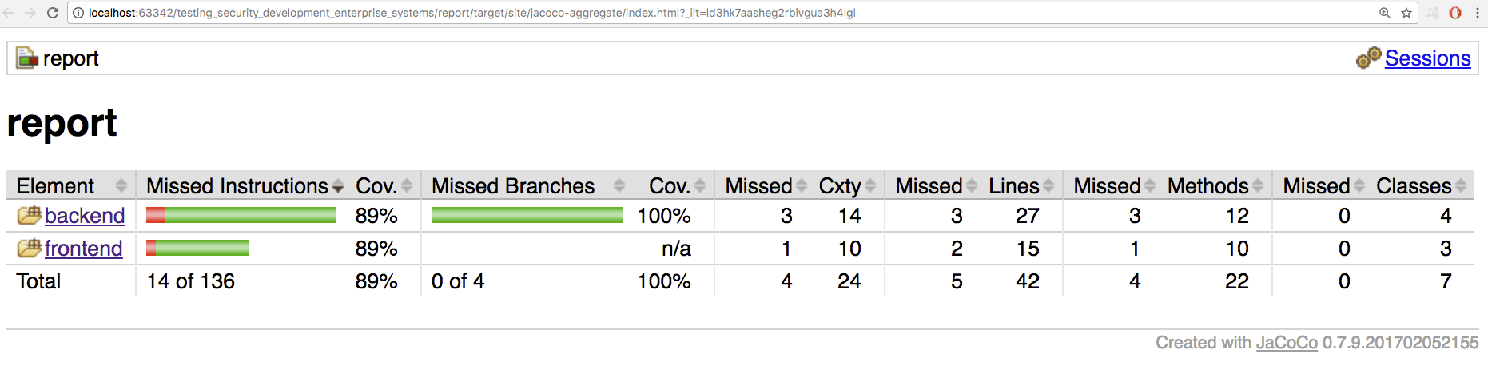

Slide 59
Instrumentation
How can a tool like JaCoCo measure coverage?
When a class is executed, its bytecode in the “.class” file is loaded into the JVM by the so called Class Loaders
Code coverage tools intercept the loading of bytecode, and modify it on the fly
The modifications do add probes, eg method calls after each statement to monitor if such statement is executed

Slide 60
Git Repository Modules
NOTE: most of the explanations will be directly in the code as comments, and not here in the slides
intro/spring/testing/selenium/jsf-tests
misc/test-utils
intro/spring/testing/selenium/crawler
intro/spring/testing/mocking
intro/spring/testing/coverage/jacoco
intro/spring/testing/coverage/instrumentation
Exercises for Lesson 09 (see documentation)

